Slide 1

VIRTUAL KEYBOARD

Slide 2
Front End Engineering-I Project
Team Details:
YASH(2310991001)
YASHMEEN(2310991003)
YATHARTH(2310991004)
Faculty Coordinator:
DR. CHETNA KAUSHAL
:
Chitkara University Institute of Engineering and Technology,
Chitkara University, Punjab

Slide 3
Table of Contents
Introduction
Problem Statement
Technical Details
Key Features
Project Highlights
Bonus Feature(optional)
Conclusion
References/Links used

Slide 4
INTRODUCTION
VIRTUAL KEYBOARD
A virtual keyboard is software that is used to emulate a standard keyboard. A picture of a keyboard is displayed on a computer screen and the user points and clicks on the pictures of keys to enter text. Switches activated in a wide variety of ways make use of the most appropriate muscles for the individual user. Virtual keyboards allow computer use by people with significant mobility impairments. Some virtual keyboards incorporate word prediction to increase entry speed.
Virtual keyboards often include multiple pages of characters containing letters, punctuation, numbers, and symbols. Depending on the device's operating system, there may also be options to insert stickers,
or animated GIFs.
Virtual keyboards are featured on smartphones, tablets, and other portable devices . That do not require the constant use of a physical keyboard. Most developers have created proprietary virtual keyboards for their devices.
They serve as an alternative input method for people who may struggle with traditional keyboards, allowing them to enter
text and navigate through computer systems more easily.
TEAM INTRODUCTION
YASH (2310991001)
YASHMEEN (23109910003)
YATHARTH (2310991004)

Slide 5
PROBLEM STATEMENT
Touch Devices without Physical Keyboards:
Many touch-based devices, such as smartphones and tablets, lack physical keyboards. Virtual keyboards provide an on-screen alternative, allowing users to input text without the need for a physical keyboard.
2. Accessibility:
Virtual keyboards are essential for users with disabilities who may have difficulty using physical keyboards. They enable alternative input methods, such as touch or mouse interactions, making computers accessible to a broader range of users.
3.Multilingual Support:
Virtual keyboards can support multiple languages without the need for physical key labels to change. Users can switch between different language layouts easily, making it convenient for multilingual individuals.
4.Security:
On-screen keyboards can enhance security by preventing hardware-based keyloggers from capturing keystrokes. This can be crucial when entering sensitive information such as passwords or personal identification numbers (PINs).
5.Embedded Systems and Touchscreen Devices:
Devices with limited physical space, such as embedded systems or certain medical equipment, might not accommodate a traditional physical keyboard. Virtual keyboards allow for text input in constrained environments.
6.Remote Desktop and Virtual Machines:
In scenarios where users access computers or virtual machines remotely, a virtual keyboard on the remote desktop interface can provide a practical input method, especially if the local device does not have a physical keyboard.
7.Temporary or Disposable Systems:
Virtual keyboards are useful in situations where setting up a physical keyboard may be impractical or temporary. For example, when entering text on a Smart TV, gaming console, or any device with limited text input requirements.
8.Reducing Costs and Weight:
In some cases, eliminating physical keyboards from device designs can reduce manufacturing costs and the overall weight of the device, making it more portable and cost-effective.

Slide 6
DEVICE SPECIFICATION
Device name: LAPTOP-R29E214C
Processor: 12th Gen Intel(R) Core(TM) i5-12450H 2.00 GHz
Installed RAM: 8.00 GB (7.68 GB usable)
Device ID: ACC09776-1E48-4319-8E6C-EF5506F0C128
Product ID: 00356-24684-51446-AAOEM
System type: 64-bit operating system, x64-based processor
Pen and touch: No pen or touch input is available for this display
WINDOW SPECIFICATION
Edition Windows 11 Home Single Language
Version 22H2
Installed on ‎12-‎08-‎2023
OS build 22621.2715
Experience Windows Feature Experience Pack 1000.22677.1000.0
SOFTWARES USED:-
VS CODE
MICROSOFT POWER POINT
MICROSOFT WORD
PROGRAMMING LANGUAGES: -
HTML
CSS
BOOTSTRAP
Technical Details

Slide 7
KEY FEATURES
Responsive Design:
Optimize the virtual keyboard for various screen sizes and resolutions, especially for mobile devices. A responsive design ensures that the virtual keyboard functions well on a wide range of devices and form factors.
Consistent User Interface:
Maintain a consistent and intuitive user interface across platforms and devices to ensure a seamless user experience.
Resizable and Movable:
Allow users to resize and move the virtual keyboard on the screen. This flexibility enables users to position the keyboard where it is most comfortable and convenient for their workflow.
Customizable Layouts:
Allow users to customize the layout of the virtual keyboard to meet their preferences and specific needs. This includes the ability to add or remove keys, rearrange them, and adjust the size of keys.
Accessibility Features:
Implement accessibility features, such as support for screen readers, voice input, and compatibility with assistive technologies. Ensure that the virtual keyboard is usable by individuals with disabilities.
Responsive Design:
Optimize the virtual keyboard for various screen sizes and resolutions, especially for mobile devices. A responsive design ensures that the virtual keyboard functions well on a wide range of devices and form factors.

Slide 8

PROJECT HIGHLIGHTS

Slide 9
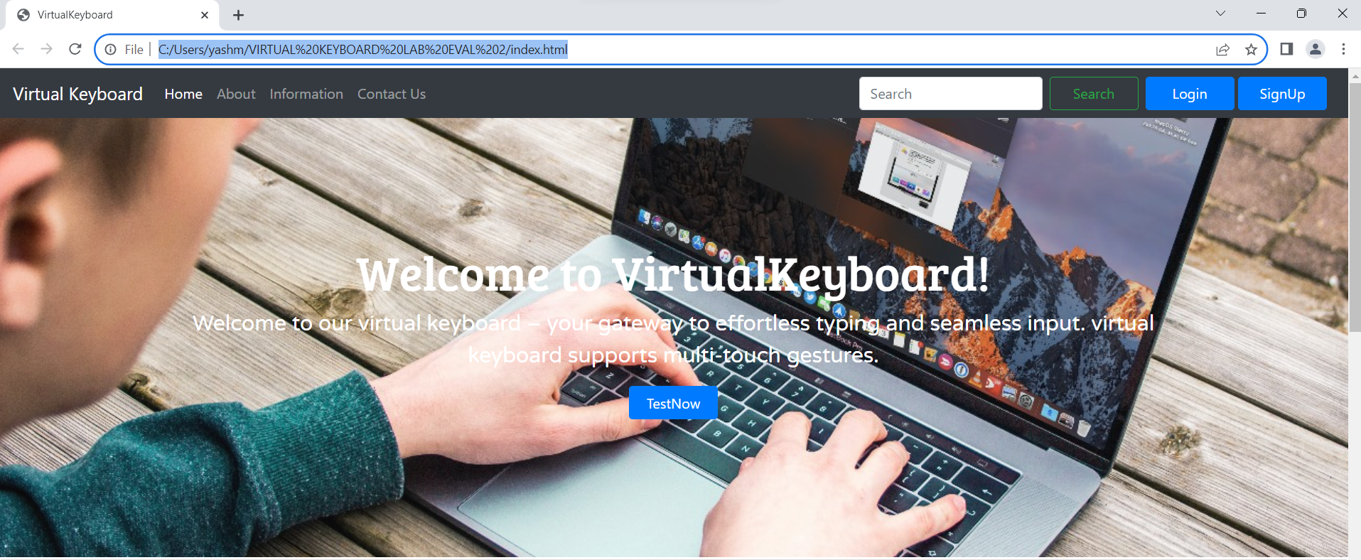
PROJECT HIGHLIGHTS

Slide 10
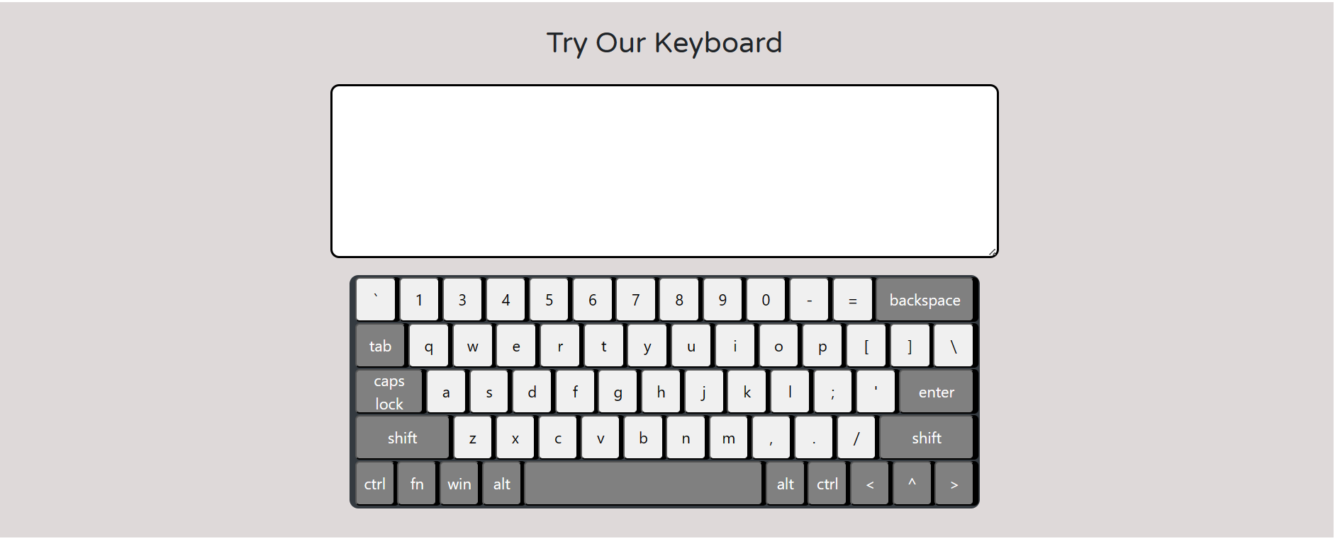
PROJECT HIGHLIGHTS

Slide 11
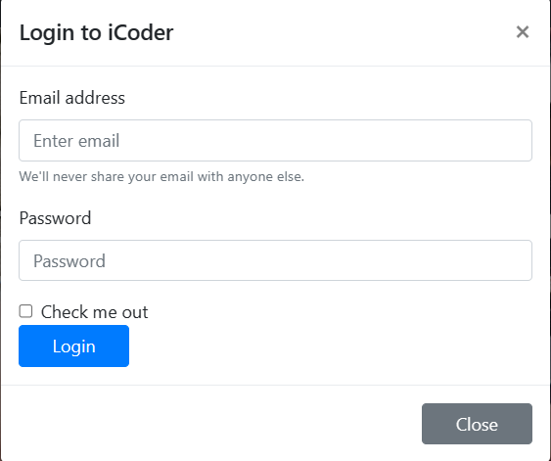
PROJECT HIGHLIGHTS

Slide 12
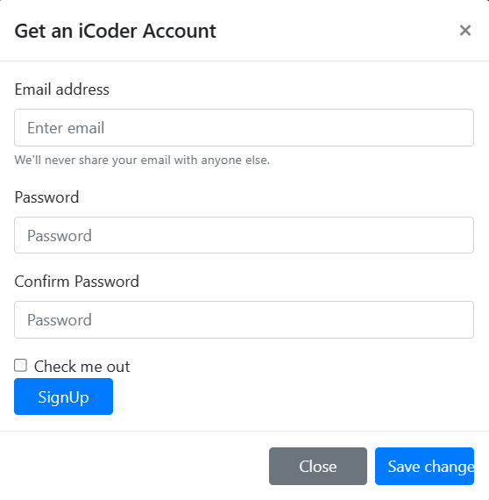
PROJECT HIGHLIGHTS

Slide 13
BONUS FEATURE(optional)
Gesture Recognition Technology:
Introduce a cutting-edge gesture recognition system that allows users to type and control the keyboard using intuitive hand movements.
Highlight how this feature enhances user experience by providing a more natural and efficient way to interact with the virtual keyboard.
2.Adaptive Learning Algorithm:
Showcase an adaptive learning algorithm that analyzes user typing patterns and continuously improves predictive text suggestions.
Explain how this feature enhances typing speed and accuracy over time, making the virtual keyboard more personalized and efficient.
3.Haptic Feedback Customization:
Introduce a customizable haptic feedback system that allows users to personalize the tactile response of the virtual keyboard according to their preferences.
Emphasize how this feature enhances the overall typing experience by providing a more sensory and engaging interaction.
4. Secure Biometric Authentication:
Showcase a biometric authentication feature integrated into the virtual keyboard, such as fingerprint recognition or facial recognition, to enhance security.
Emphasize how this innovation ensures a secure and convenient way for users to access their devices.

Slide 14
FUTURE SCOPE
FUTURE STEPS
User Feedback Loop:
Establish a continuous feedback mechanism for ongoing improvement.
2.Explore Emerging Technologies:
Stay at the forefront of technological advancements for potential integrations.
3.Expand Collaboration:
Partner with other teams for cross-functional innovation.
4.Marketing and User Education:
Effectively communicate features to users for optimal utilization.

Slide 15
CONCLUSION
Team's Takeaways:
Innovation Pays Off
Successful integration of cutting-edge technologies.
2.User-Centric Design
Prioritizing user experience with adaptive learning and customization.
3.Versatility in Language and Input
Meeting the diverse needs of users globally.
4.Enhanced Security Measures
Biometric authentication elevates device security.
5.Continuous Improvement
Commitment to refining features based on user feedback.
6.Future-Ready Technology
AR projection opens doors for future developments.

Slide 16
REFERENCES/LINKS USED
Seminarsonly.com:
https://www.seminarsonly.com/computer%20science/Virtual%20keyboard.php
2. UNIVERSITY OF WASHINGTON:
https://www.washington.edu/accesscomputing/what-virtual-keyboard
3. IJSER:
https://www.ijser.org/paper/Virtual-Keyboard-2014.html
4. WIKIPEDIA:
https://en.wikipedia.org/wiki/Virtual_keyboard
5. SLIDE SHARE:
https://www.slideshare.net/siddhantranjan/virtual-keyboard-36251213
6. DiVA PORTAL:
https://www.divaportal.org/smash/get/diva2:669114/FULLTEXT01.pdf

Slide 17


